Slide 2
Empowered by FRIWO
Company Profile

Slide 3
Company Profile
01 FRIWO in time lapse
02 The company today: our range of services
03 Figures & facts
04 Our production sites: the best of two worlds
05 Extract: current portfolio highlights

Slide 4
FRIWO in time lapse
01

Slide 5
1971: The beginning of a success story
Friemann & Wolf develops the world's first plug-in power supply.

Slide 6
FRIWO in time lapse: The milestones
New corporate structures FMP business unit sold to Flextronics
CEAG AG is taken over by VTC and renamed FRIWO AG
Expansion FRIWO founds its own subsidiary in India, one of the world's strongest growth markets for electric mobility
The "golden power supply" Production of 1.000.000.000 power supplies
FRIWO acts as a system provider Digitally controllable, precisely matched power supply and drive solutions from a single source
FRIWO is divided into two divisions FRIWO Mobile Power (FMP) and FRIWO Power Solutions (FPS)
Takeover of Emerge-Engineering GmbH Developer and manufacturer of components for electric drives
Certification according to DIN ISO 9001 As the first company in the industry
Certification according to DIN ISO 13485 An additional quality promise for medical technology
Acquisition by CEAG AG Turnover: DM 73 million / Employees: 640
Grand Opening Vietnam Opening of a state-of-the-art production facility in Vietnam
Europe's largest manufacturer of small power supplies and chargers Manufacturing of 25,000 units per day
A first step towards a system concept The company starts manufacturing battery packs
Invention of the world's first plug-in power supply unit Used for cassette recorders - production output: 1,000 units per day
Breaking through the sales barrier
FRIWO generates sales of over 100 million euros for the first time
1971
1982
1983
1992
2002
2005
2008
2013
2014
2016
2018
2019
2020

Slide 7
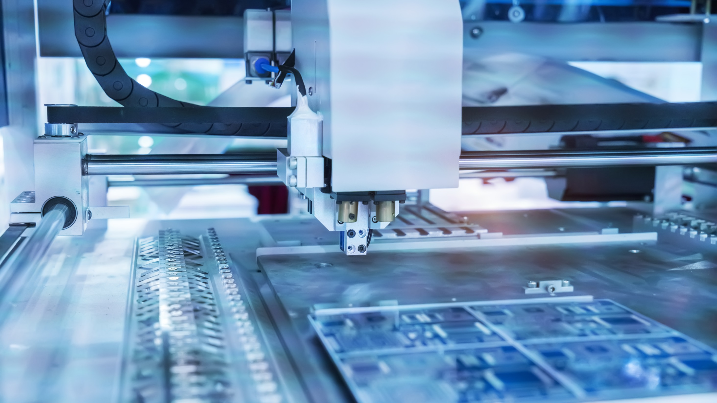
2020: High-tech supplier with a global footprint
FRIWO offers digitally controllable, precisely matched power supply and drive system solutions from a single source.

Slide 8
The company today: our range of services
02

Slide 9
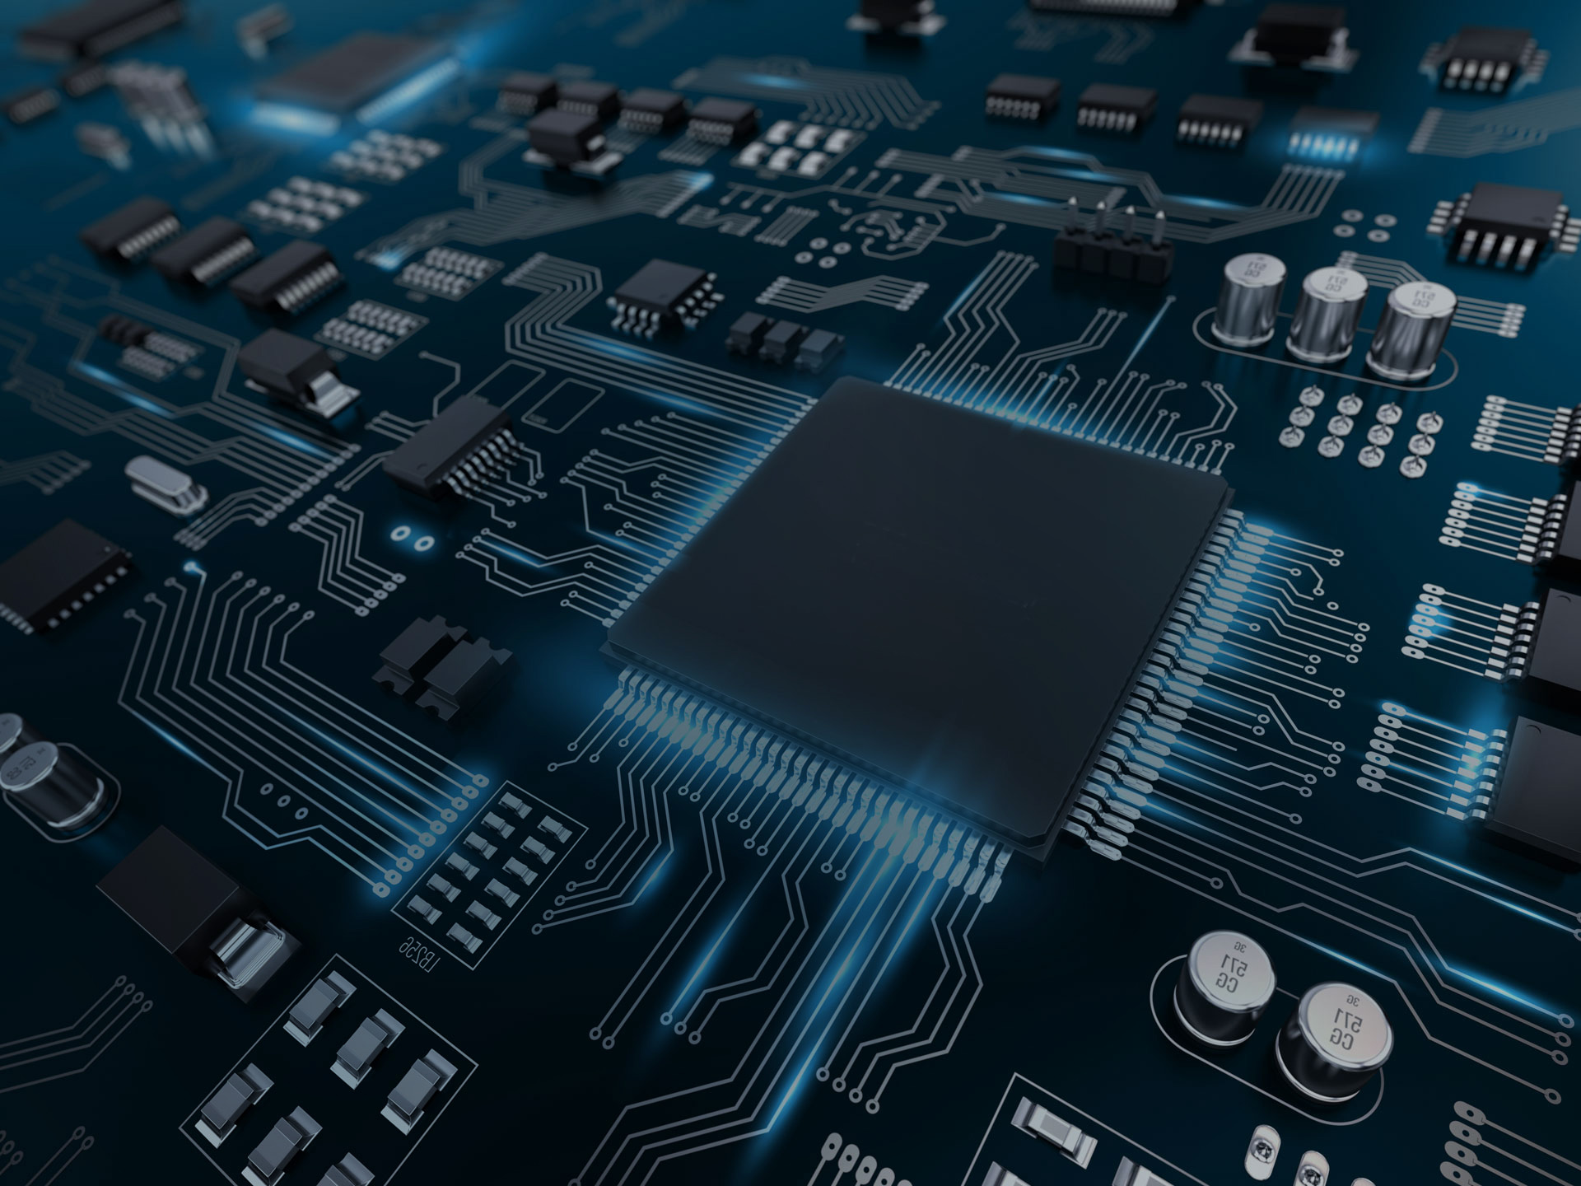
Our product portfolio
Power supply systems
Power supplies
Chargers
Battery packs
LED drivers
Drive system solutions
Motor controllers
Service software
Drive units
Vehicle control units
Displays
Chargers
Battery packs

Slide 10
Solutions for demanding future markets
Tools
Industrial
Medical
E-Mobility

Slide 11
What we stand for
Brand & Claim
FRIWO enables its customers to improve their products and differentiate themselves in the market.
Brand promise
Highly reliable quality
Absolute customer orientation
Core competencies
Smart intelligence
Innovativeness

Slide 12
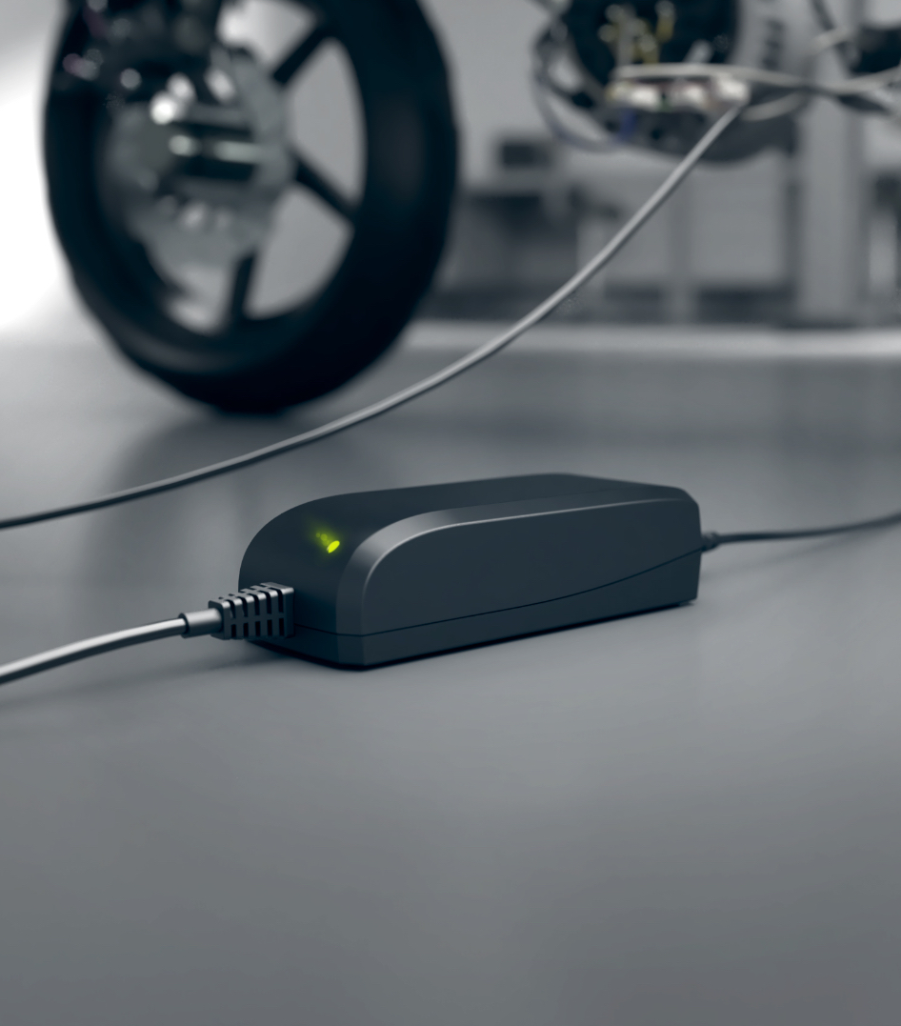
Our development know-how:
Power supply systems
Highly efficient power supply solutions with up to 1,000 W power output
Microcontroller operated charging systems with up to 500 W output power
Medical technology solutions with ~0 µA leakage current
Over 20 years of experience in ASIC design
Patented primary PWM controller
Use of ICs to protect against product piracy

Slide 13
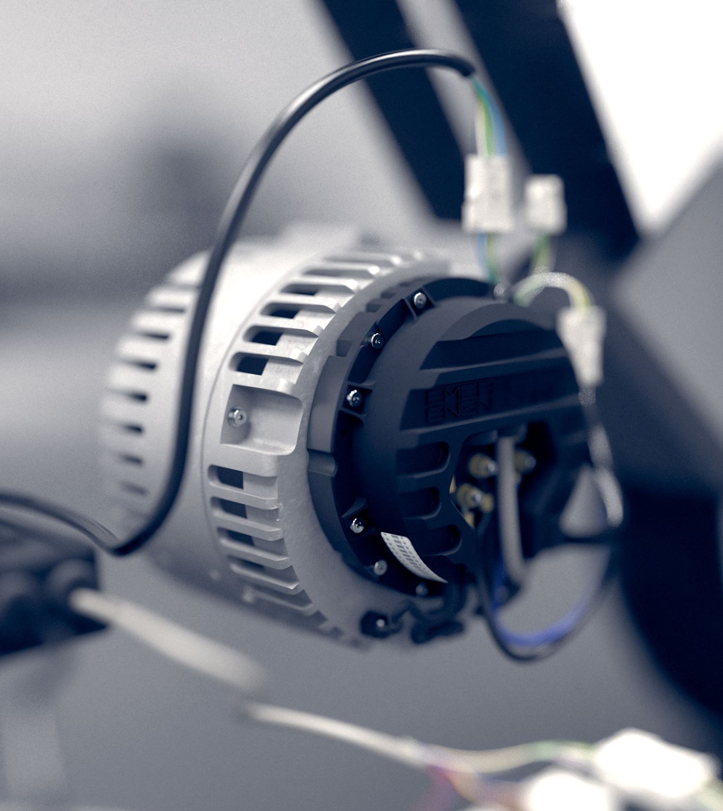
Our development know-how:
Drive systems
Solutions for 48 V drive systems with up to 12 kW power output
Modular system for the individual electrification of drive units
Highly efficient control algorithms for hybrid synchronous machines
State-of-the-art communication interfaces
Robust solutions for continuous outdoor use under all climatic conditions

Slide 14
“Quality first”
Own FRIWO laboratory
In-house approbation department
State-of-the-art development instruments
EMC cabin
3D prototyping
X-ray control
Waterproof test
Climatic test
Drop test
Pull test
Vibration test
DFMEA

Slide 15
Our global network: Production flexibility with local contacts
FRIWO China
Sales & Service
FRIWO Germany (HQ)
Administration, Sales,
R&D & Production
FRIWO India
Sales & Service
FRIWO Vietnam
R&D & Production
Sales Offices & Distribution

Slide 16
Figures & facts
03

Slide 17
Key figures
Ready for future growth thanks to high production capacities: Strong increase in headcount due to construction of a state-of-the-art, vertically highly integrated production facility in Vietnam

Slide 18
Our production sites: the best of two worlds
04

Slide 19
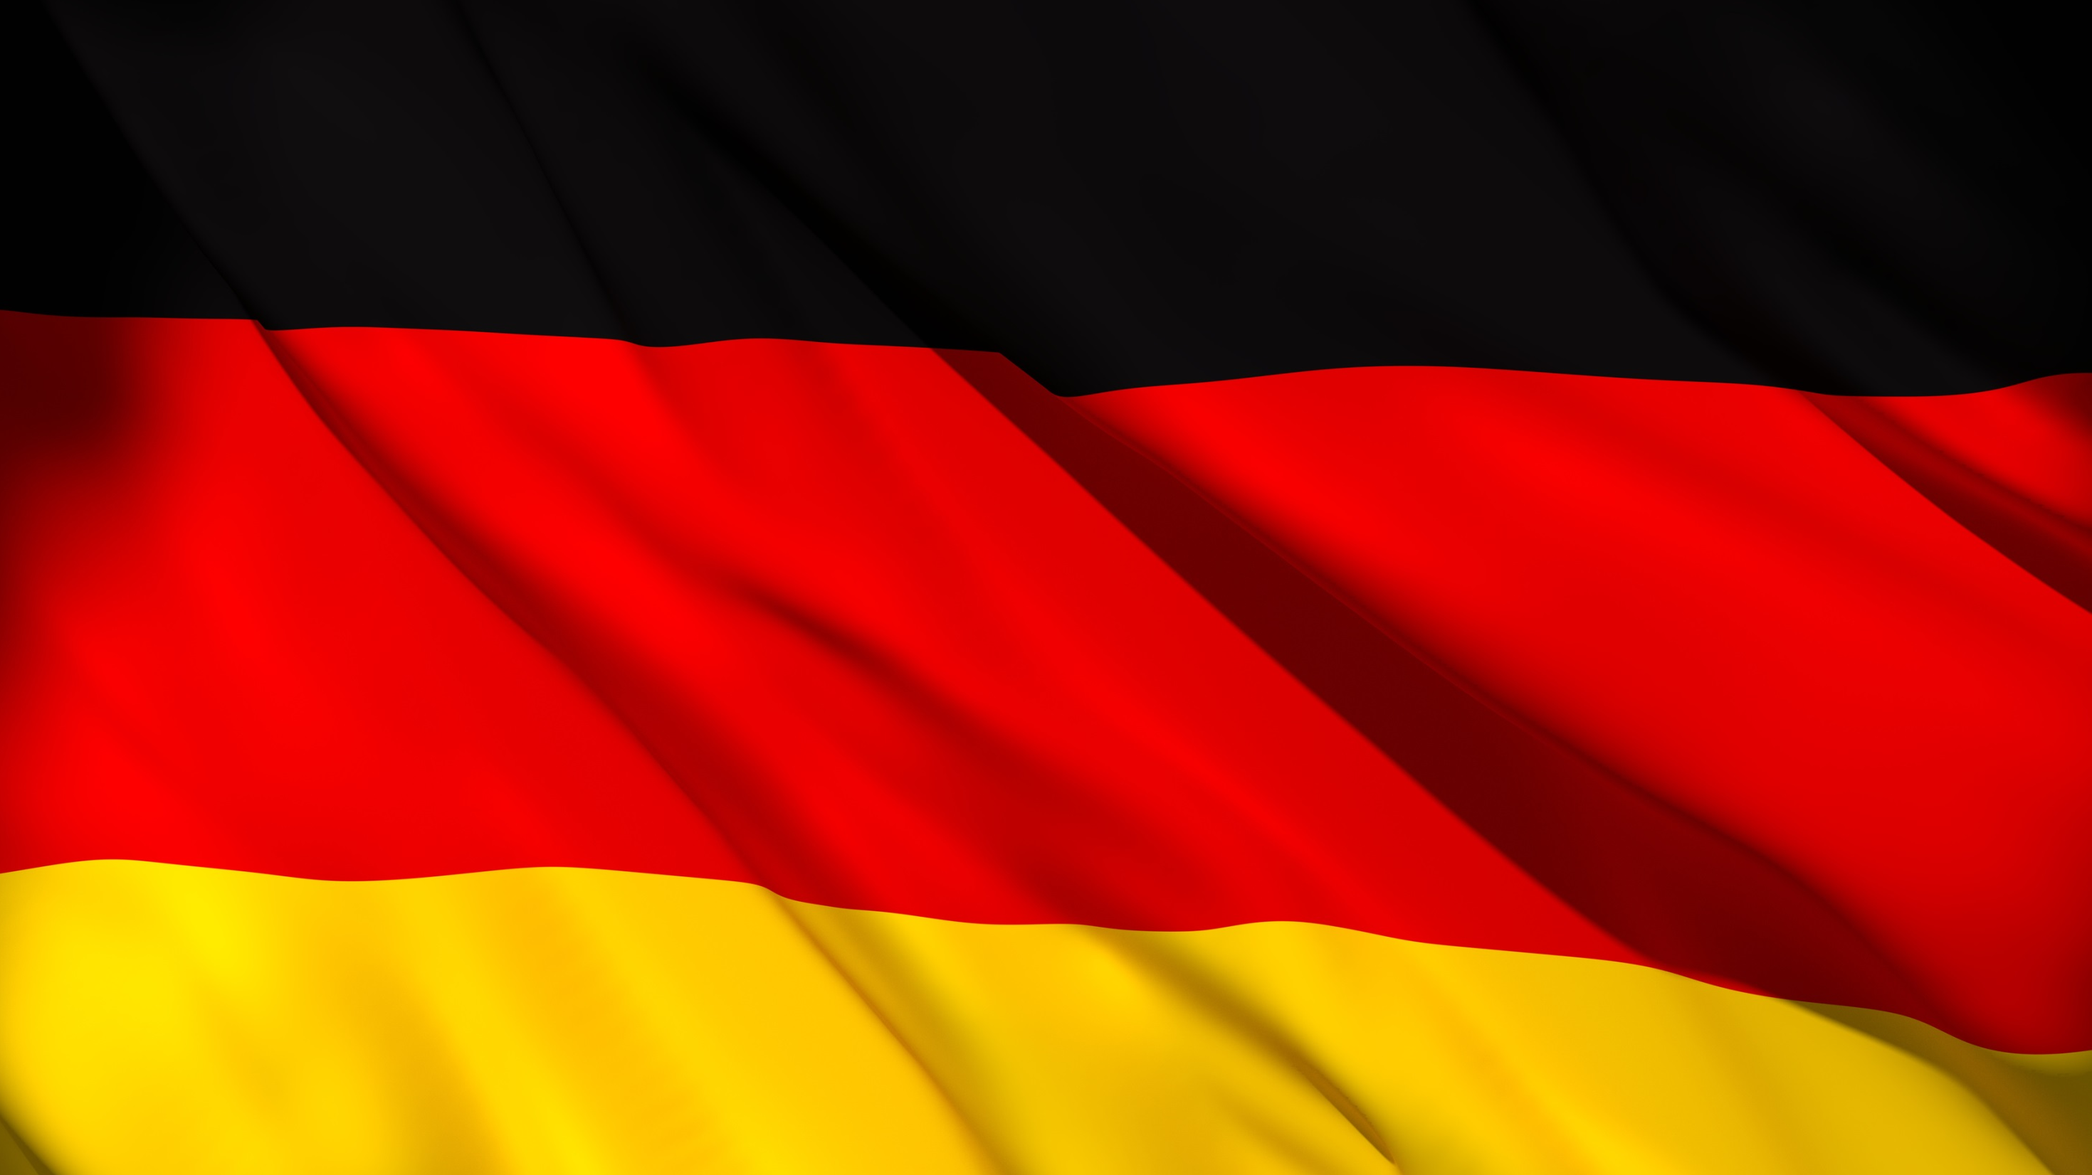
Ostbevern: highly flexible production offers shortest delivery times

Slide 20
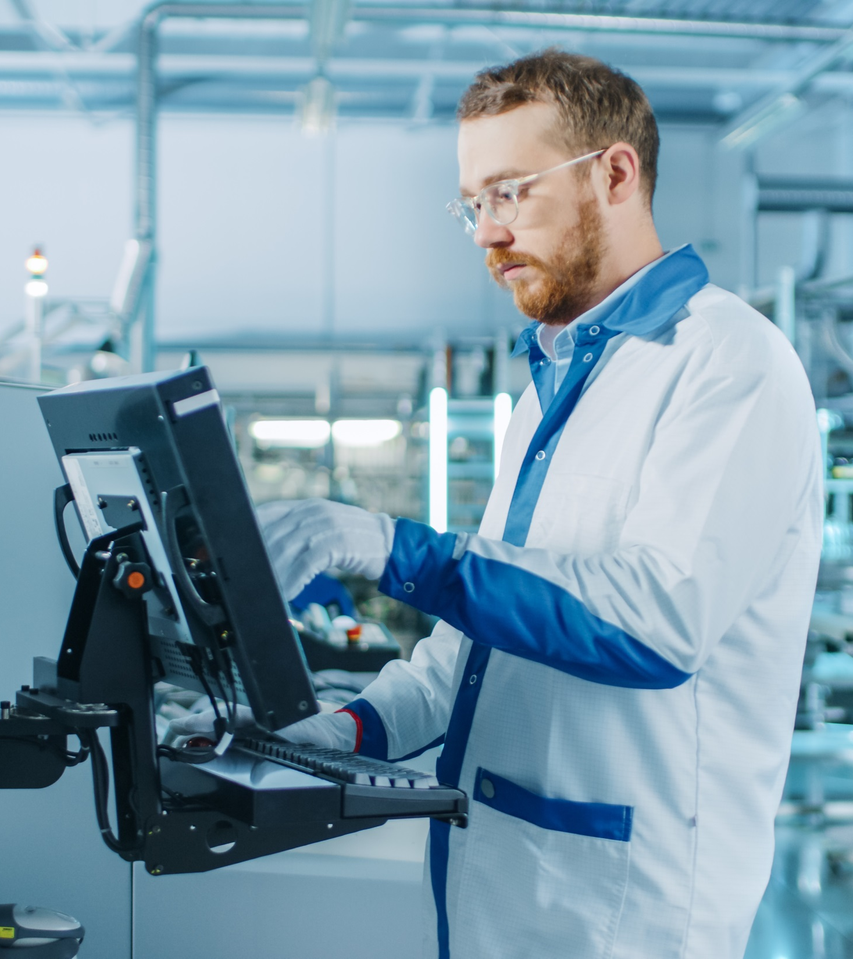
FRIWO Germany
Focus on the flexible production of power supplies and chargers in smaller quantities
Production centre for battery packs
Modern production facilities with the highest degree of automation
Last minute customization of standard products: shortest delivery times for European customers
ISO 9001, ISO 13485 and ISO 14001 certifications

Slide 21
Dong Nai: European manufacturing know-how meets attractive production conditions in Asia

Slide 22
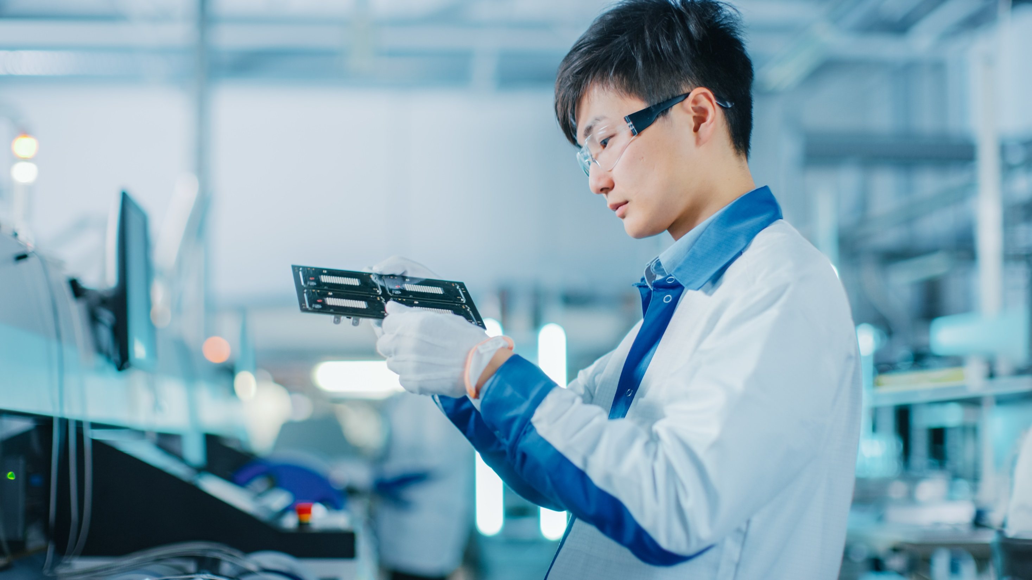
FRIWO Vietnam
Competence centre for the production of complex chargers and power supplies
Production according to European standards under German management
Focus on production of higher quantities
Modern quality department on site
Own training center for employees
Certification according to SA 8000, ISO 9001 and ISO 14001

Slide 23
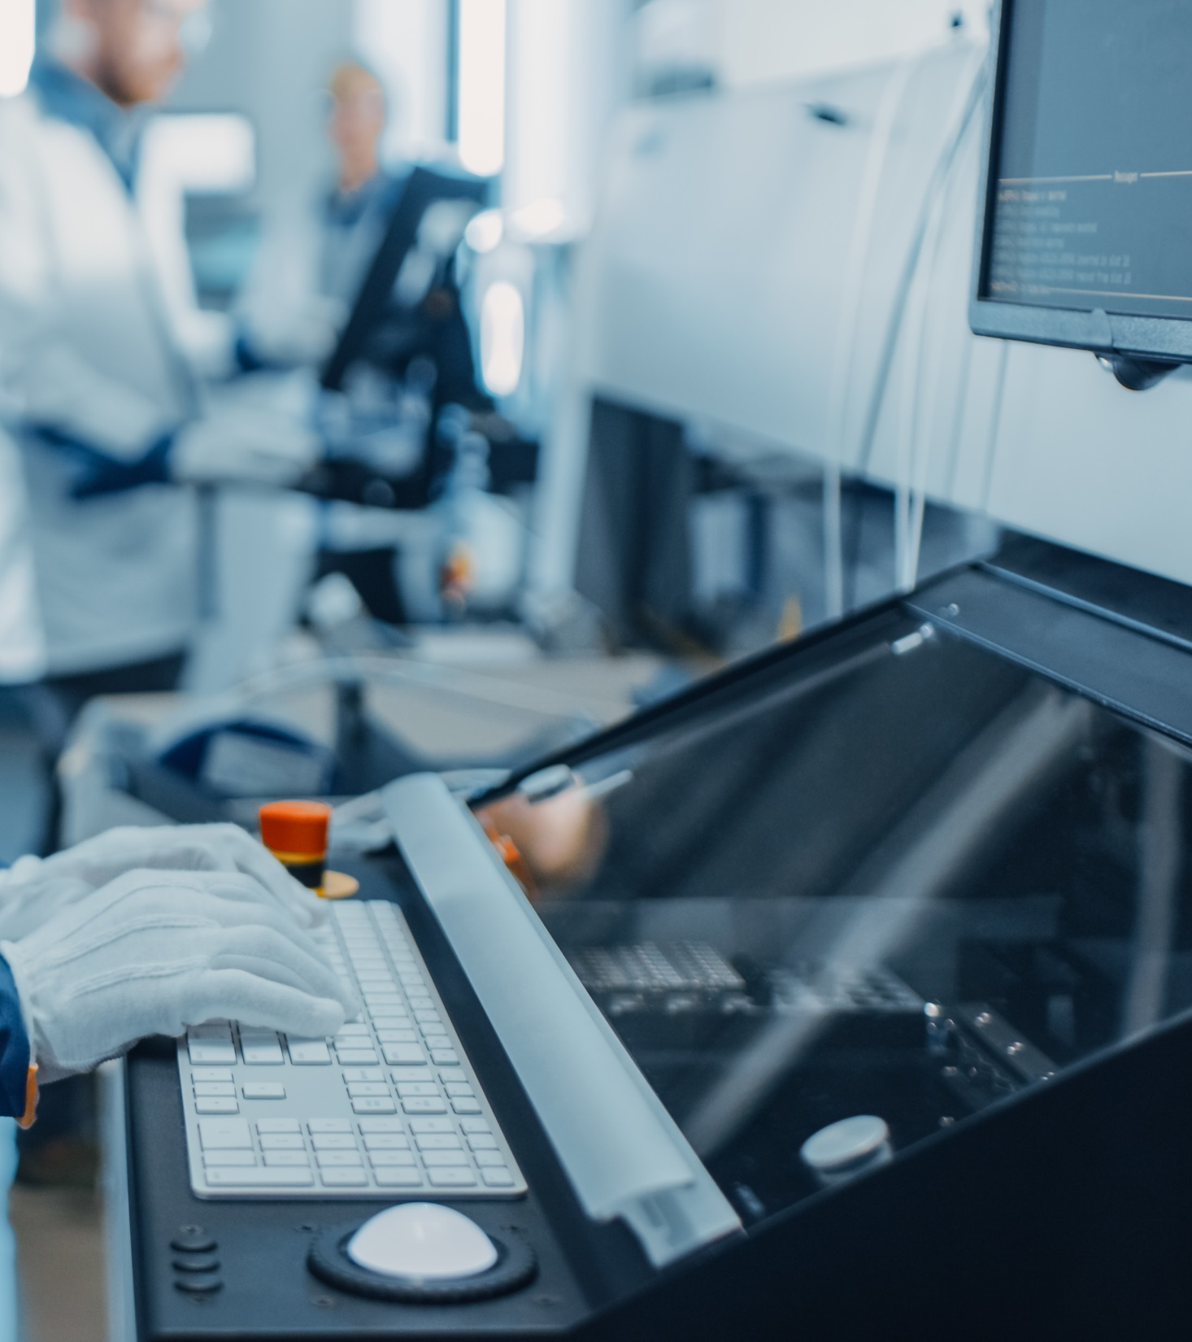
Highest quality thanks to European equipment
Modern nitrogen wave soldering machines from German manufacturer
Own nitrogen generator and air compressor from German manufacturer
Fully automated varnish line
Full temperature and humidity control inside warehouse and production
ESD floor in the entire production

Slide 24
Vertical integration in Vietnam: Maximum supply security and highest quality control
Sourcing
In-circuit test
Final assembly & test
Automated test system
THT
SMT
Manual assembly
Wave soldering
PCB
Housing
Others
Transformer
Cable
5%
17%
Own transformer production (2017)
Own cable assembly (2018)
Own injection moulding machines (2019)
Typical distribution of components
19%
10%
49%

Slide 25
Our factories in Vietnam
Plant I
Production of power supplies and chargers
THT & SMT
Competence center for wave soldering
Total area 10.827 m²
Production 3.000 m²
Warehouse 1.000 m²
Office 1.025 m²
Available production hours per month:*
Single shift system: 140.000 h
Two shift system: 270.000 h
Plant II
Production of transformers, chokes and coils
Total area 7.500 m²
Production 5.000 m²
Warehouse 1.000 m²
Office 400 m²
Available production hours per month:*
Single shift system: 180.000 h
Two shift system: 320.000 h
Plant III
Production of DC cables and wires
Production of housings and plastic bobbins
Warehouse for raw materials and finished products
Total area 11.000 m²
Production 3.200 m²
Warehouse 4.000 m²
Office 400 m²
Available production hours per month:*
Single shift system: 100.000 h
Two shift system: 170.000 h
* Maximum possible hours in case all lines are installed and set-up

Slide 26
Extract: current portfolio highlights
05

Slide 27
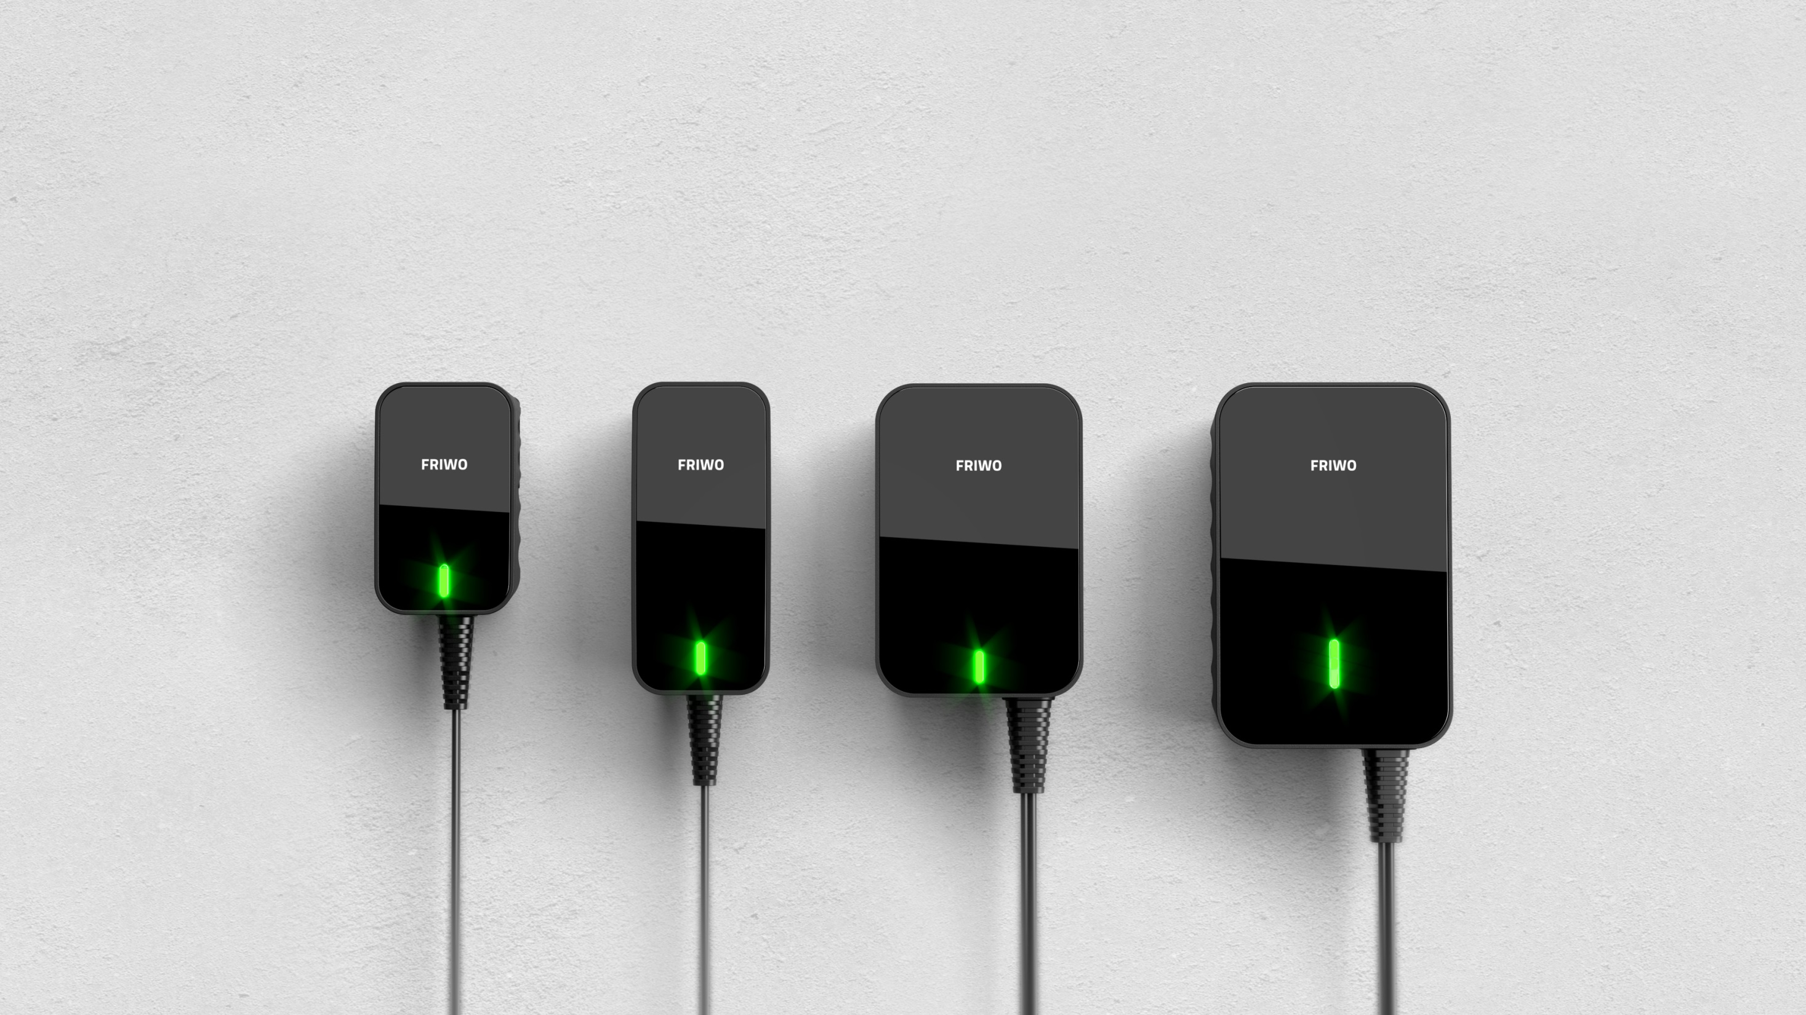
Design meets technology: FOXNEO A standard product that sets new standards
6W
12W
18W
30W

Slide 28
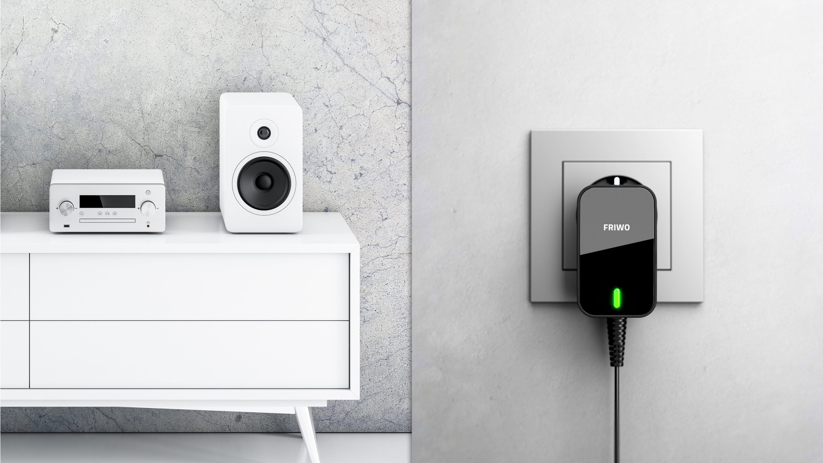
FOXNEO
Flexibility thanks to high configurability
Wide range of interchangeable adapters
Unique design
3 years warranty
Conformity:
EN/IEC 62368-1
Medical 4th edition
VO EG 278/2009
Customization by laser printing

Slide 29
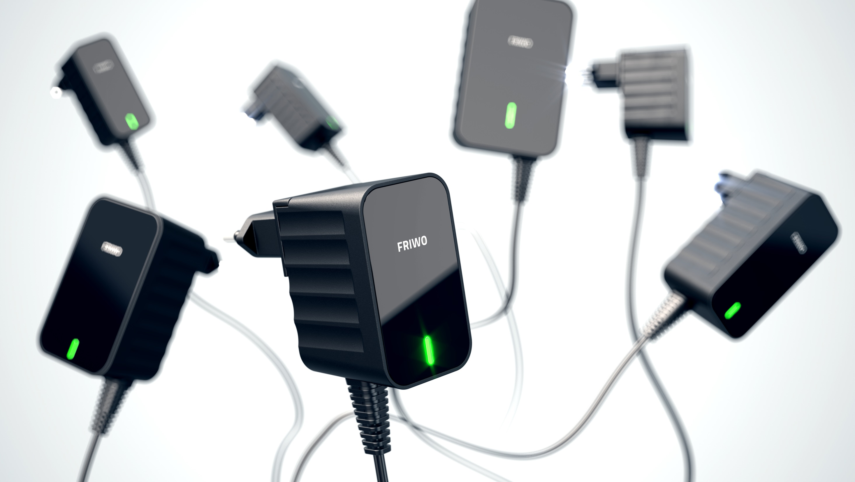
FOXNEO
Maximum availability: 48 hours delivery time EXW Ostbevern (GER) after order confirmation
This delivery time only applies to orders placed via www.NEOconfigurator.com and depends on quantities: ≤ 250 pcs: 48 hours ≤ 1.000 pcs: 14 days

Slide 30
Compact e-bike charger as optimal travel companion
Shortest charging times thanks to high currents: Two power classes available with 4 A or 6 A
5 V / 50 mA output for battery electronics
Variety of communication options, e.g. CAN-Bus
With PFC and resonant circuit
Fanless design for noiseless charging
Closed housing without any ventilation slots
Surface temperature of max. 65°C
Safety: integrated temperature protection, timer, current limiting

Slide 31
FRIWO Systems
Digitally controllable power supply and drive system solutions from one source
Example: E-Scooter
1
7
5
1 – Display
2 – Vehicle control unit
3 – Drive unit
4 – Motor controller
5 – Battery pack
6 – Charger
7 – Service software
3
4
2
6

Slide 32
Emerge 6000: best-in-class motor controller
Field-oriented control incl. field weakening
6 kW power with boost function
Automatic teach-in function
Communication via Bluetooth and CAN
4 driving mode settings
Highest possible efficency
Reverse gear
Control via smartphone app
Small form factor

Slide 33
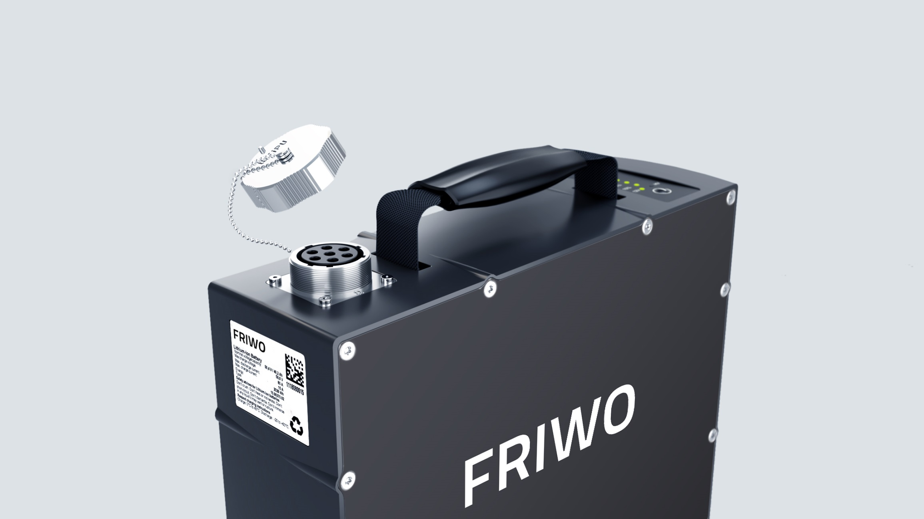
Our standard battery pack: a detailed view
Energy 2216 Wh
Samsung INR 18650 35E cells
Continuous current 50 A
Peak current 65 A
14S/12P cell layout
Standby < 0.1 mA
Nominal voltage 50.4 V
CAN bus communication
Diagnostic interfaces: USB, CAN

Slide 34
The alternative: our high power pack
Energy 1814 Wh
Samsung INR 18650 30Q cells
Continuous current 140 A
Peak current 180 A
14S/12P cell layout
Standby < 0.1 mA
Nominal voltage 50.4 V
CAN bus communication
Diagnostic interfaces: USB, CAN

